Slide 1


BOOTSTRAP
Lecture-13

Slide 2
Today’s Agenda
BootStrap Forms
Forms Using Grid
Horizontal Forms
Sizing Controls

Slide 3
BootStrap Forms
Forms are made of labels, inputs, help elements and buttons.
All the elements need to be placed in a <form> tag.
To provide a structure, we can put group inputs, labels and help text into a .form-group with their classes set to form-control

Slide 4
Example
<form>
<div class="form-group">
<label for="email1">Email address</label>
<input type="email" class="form-control" id="email1" aria-describedby="emailHelp" placeholder="Enter email">
<small id="emailHelp" class="form-text text-muted">Your information is safe with us.</small>
</div>
<div class="form-group">
<label for="password1">Password</label>
<input type="password" class="form-control" id="password1" placeholder="Password">
</div>
<button type="submit" class="btn btn-info">Submit</button>
</form>

Slide 5
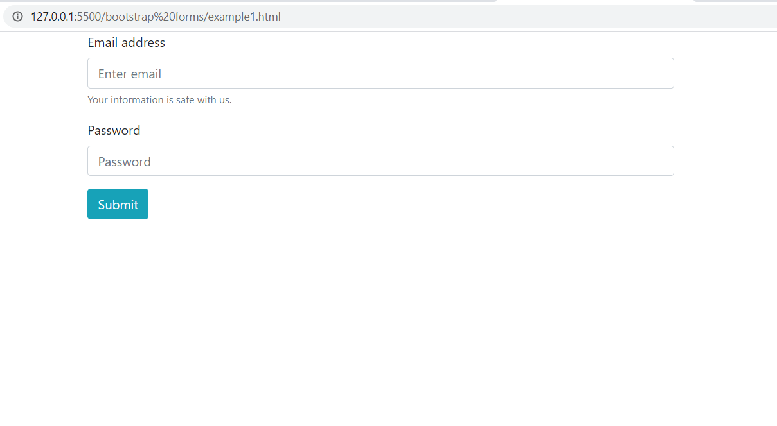
Output

Slide 6
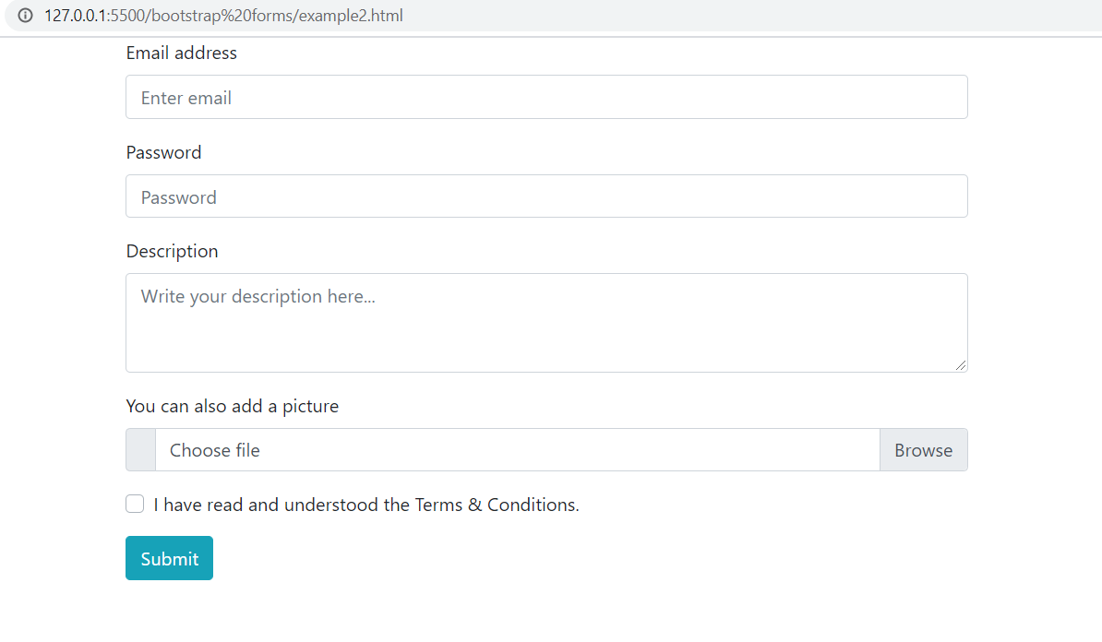
Exercise

Slide 7
Form Using Grid
One of the simplest way to position elements on a row is to use the grid system.
Inputs are block elements, so they will have the width of their parent.
That means that in order to size an input, we need to determine the width of its parent .col

Slide 8
Example
<form>
<div class="row">
<div class="col form-group">
<input type="text" class="form-control" placeholder="First name">
</div>
<div class="col form-group">
<input type="text" class="form-control" placeholder="Last name">
</div>
</div>
<div class="row">
<div class="col-sm-12 col-md-4 form-group">
<input type="text" class="form-control" placeholder="City">
</div>
<div class="col-sm-12 col-md-4 form-group">
<input type="text" class="form-control" placeholder="Zipcode">
</div>
<div class="col-sm-12 col-md-4 form-group">
<input type="text" class="form-control" placeholder="Country">
</div>
</div>
<button type="submit" class="btn btn-info">Submit</button>
</form>

Slide 9
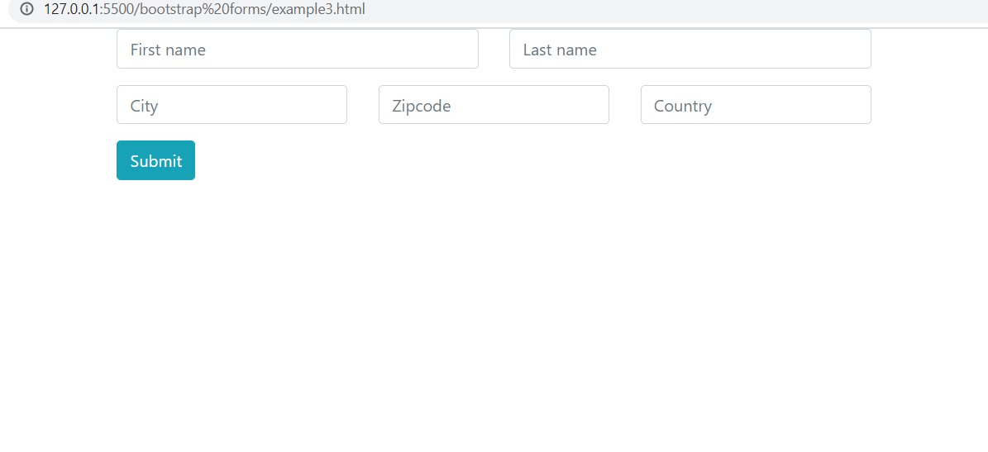
Output

Slide 10
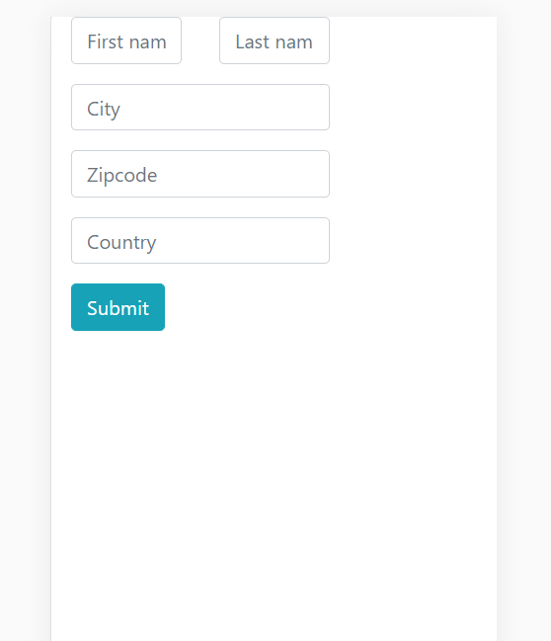
Output

Slide 11
Horizontal Forms
Another style we could go for in our forms is to have the label and input on the same row: the label on the left and the input on the right.
We can achieve this by assigning the .form-group to a .row and defining the width of the label and input with cols.
The label will align by default to the top of the .row, so we need to add the .col-form-label for the label to be vertically centered.

Slide 12
Example
<form>
<div class="form-group row">
<label for="email5" class="col-sm-2 col-form-label">Email</label>
<div class="col-sm-10">
<input type="email" class="form-control" id="email5" placeholder="Email">
</div>
</div>
<div class="form-group row">
<label for="password5" class="col-sm-2 col-form-label">Password</label>
<div class="col-sm-10">
<input type="password" class="form-control" id="password5" placeholder="Password">
</div>
</div>
.
.
.

Slide 13
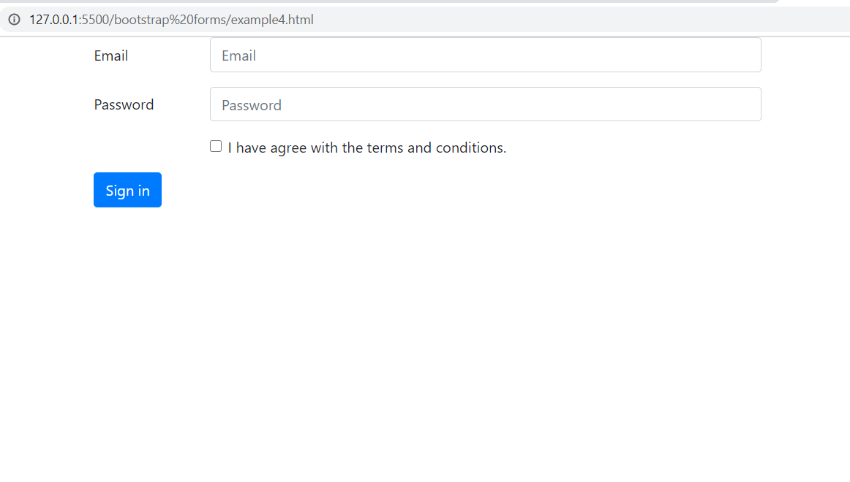
Output

Slide 14
Sizing Labels
We may use inputs that are smaller or larger than the default version.
In order to have the label match the input we will need to use the classes: .col-form-label-sm for smaller labels and .col-form-label-lg for bigger labels.

Slide 15
Example
<form>
<div class="form-group row">
<label for="inputSm" class="col-sm-2 col-form-label col-form-label-sm">Small</label>
<div class="col-sm-10">
<input type="email" class="form-control form-control-sm" id="inputSm" placeholder="col-form-label-sm">
</div>
</div>
<div class="form-group row">
<label for="input" class="col-sm-2 col-form-label">Default</label>
<div class="col-sm-10">
<input type="email" class="form-control" id="input" placeholder="col-form-label">
</div>
</div>
<div class="form-group row">
<label for="inputLg" class="col-sm-2 col-form-label col-form-label-lg">Large</label>
<div class="col-sm-10">
<input type="email" class="form-control form-control-lg" id="inputLg" placeholder="col-form-label-lg">
</div>
</div>
</form>

Slide 16
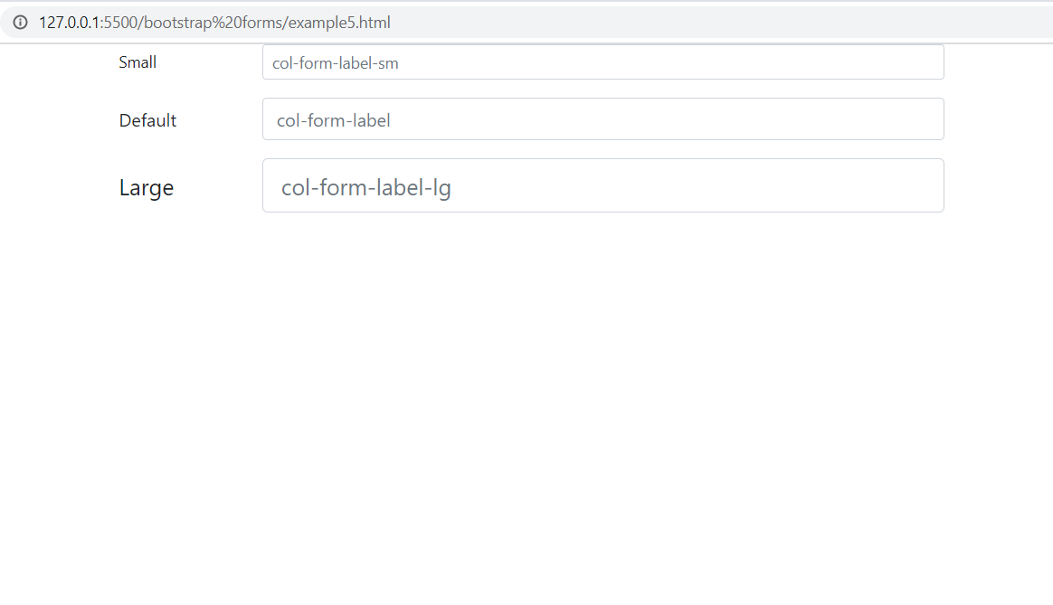
Output

